Slide 1

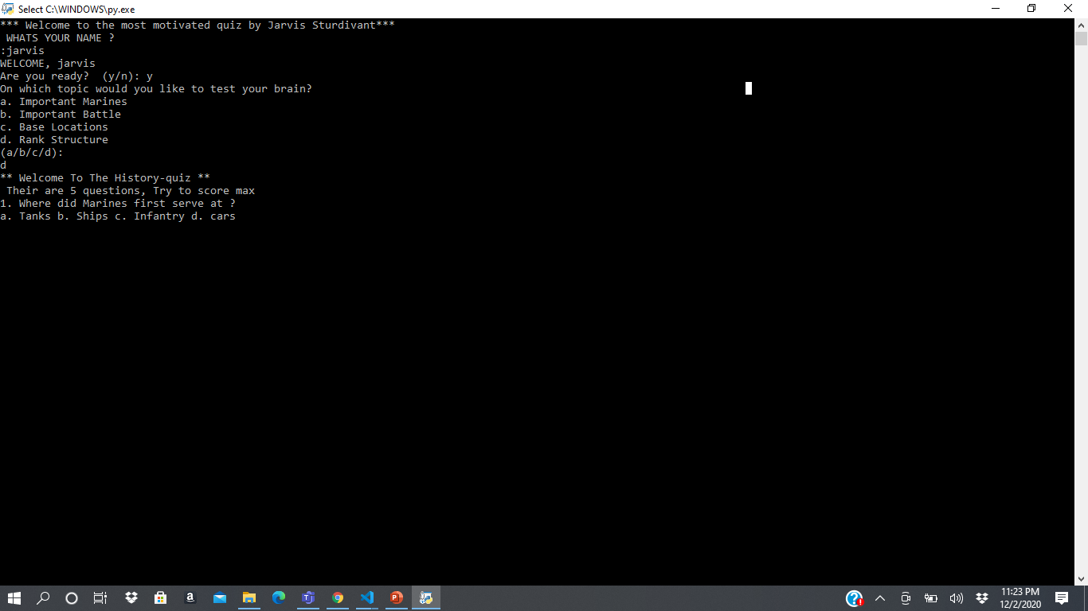
The USMC Quiz! By Jarvis Sturdivant
This is the most motivated Quiz you could ever take. You can challenge your friends and Co workers on who going to be the next leader of Marines
This Photo by Unknown Author is licensed under CC BY

